Slide 1
Recommendation Systems - End Term Project
News Recommendation System
April 28, 2023

Slide 2
Team Members
Pavan Thanay (IMT2020024)
Krushikar Reddy (IMT2020043)
Chaithanya Reddy (IMT2020054)
Samarth Gattu (IMT2020062)
Sougandh Krishna (IMT2020120)

Slide 3
Why News Recommendation System? Social utilities?
Combatting biases: News recommendation systems can help break users out of filter bubbles by exposing them to news articles that challenge their existing beliefs and opinions. This can promote critical thinking and reduce polarization in society.
Encouraging engagement with news: News recommendation systems can suggest articles that are relevant to users' interests, making it more likely that they will engage with the news and stay informed about current events.
Supporting the news industry: News recommendation systems can help news organizations reach new audiences and increase engagement with their content, which can ultimately support the financial sustainability of the news industry.

Slide 4
How is News Recommendation System challenging compared to others?
Severe Cold-start problem
User cold-start problem - Login and new user problem
Product cold-start problem - Large number of new news articles
In traditional recommendation systems we have user ratings to each item, but we do not have explicit news article ratings.
Item representation for news articles must be based on it’s content.
Real time Updates to the dataset.

Slide 5


Hence a Challenging Problem!!

Slide 6
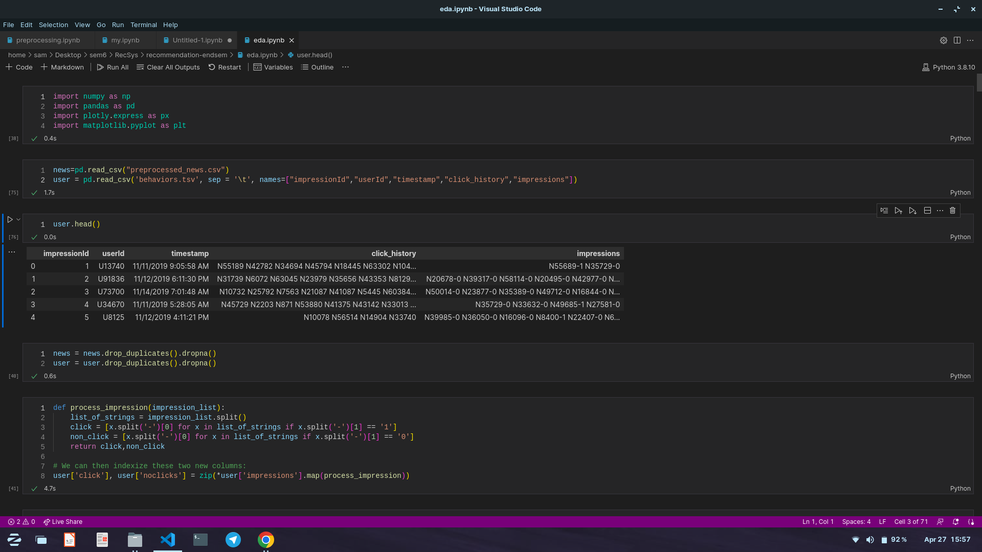
MIND dataset
behaviour.tsv - This file contains the click history of the user, all the impressions shown to the user and the impression time, and the user clicks.
An impression log records the news articles displayed to a user when the user visits the news page at some specific time.

Slide 7
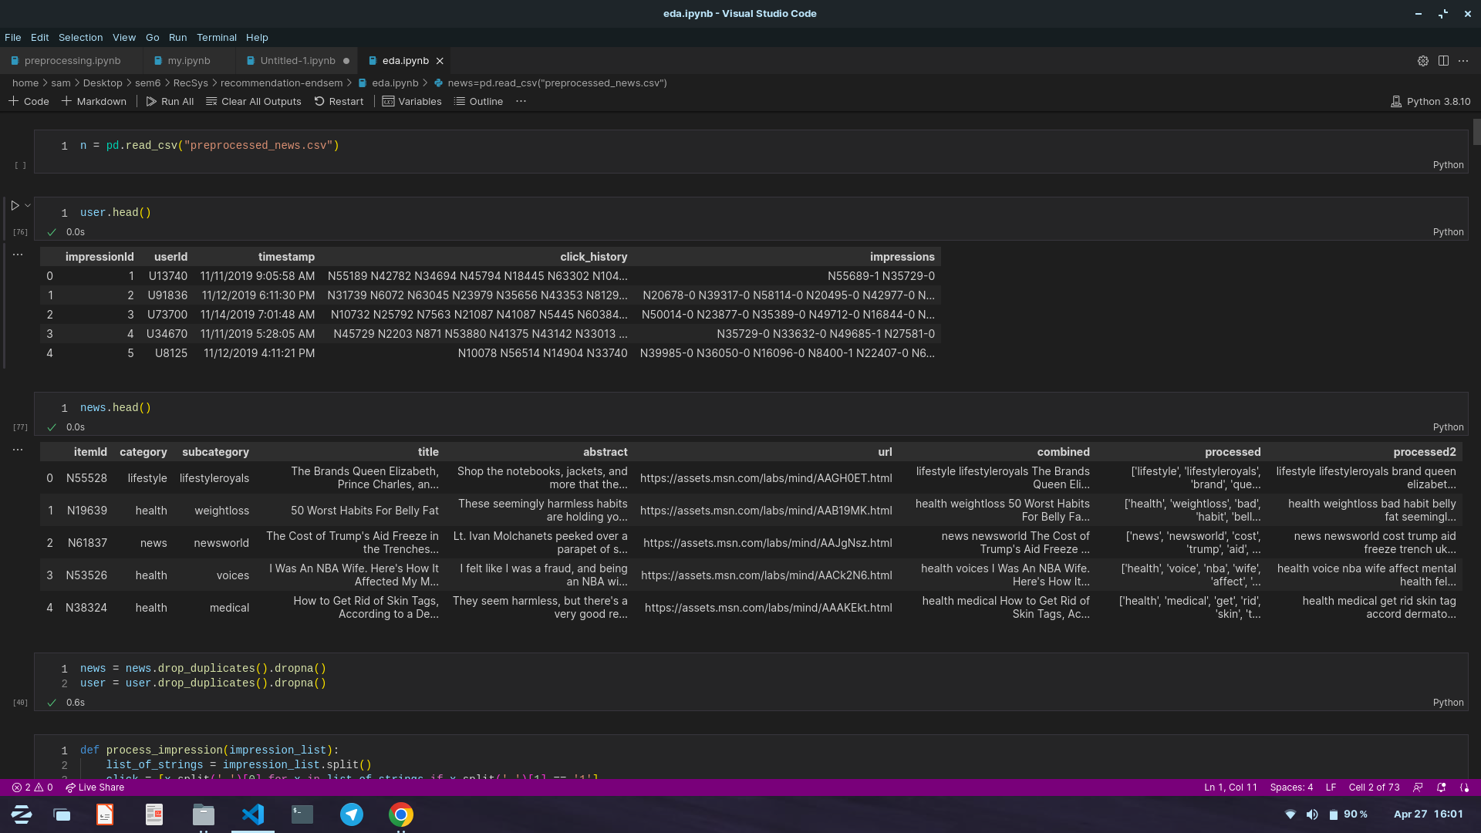
MIND dataset
news.tsv - This file contains the description of each news article.
The survival time of more than 84.5% news articles is less than two days.
News-id
URL
Category
Sub-category
Title
Abstract

Slide 8
EDA
The news dataset contains 17 categories and 264 sub categories.
60% of the news articles belong to either news or sports category.
The dataset consists of the user behaviour records between the period November 9, 2019 to November 14, 2019.
Users click only approximately 4% of the news articles shown to him.
Approximately more than 30,000 news articles (60%) are not even displayed to the user in this time period.
Each user in the dataset have at least 17 news article clicks in this period.

Slide 9
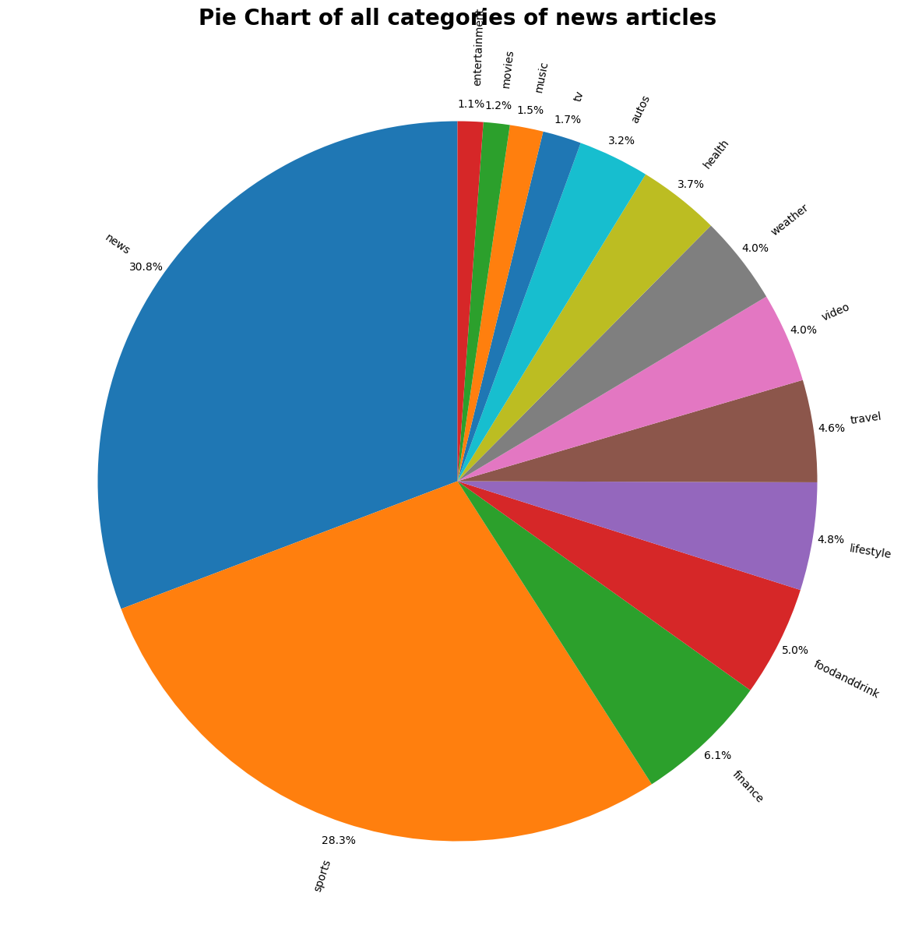
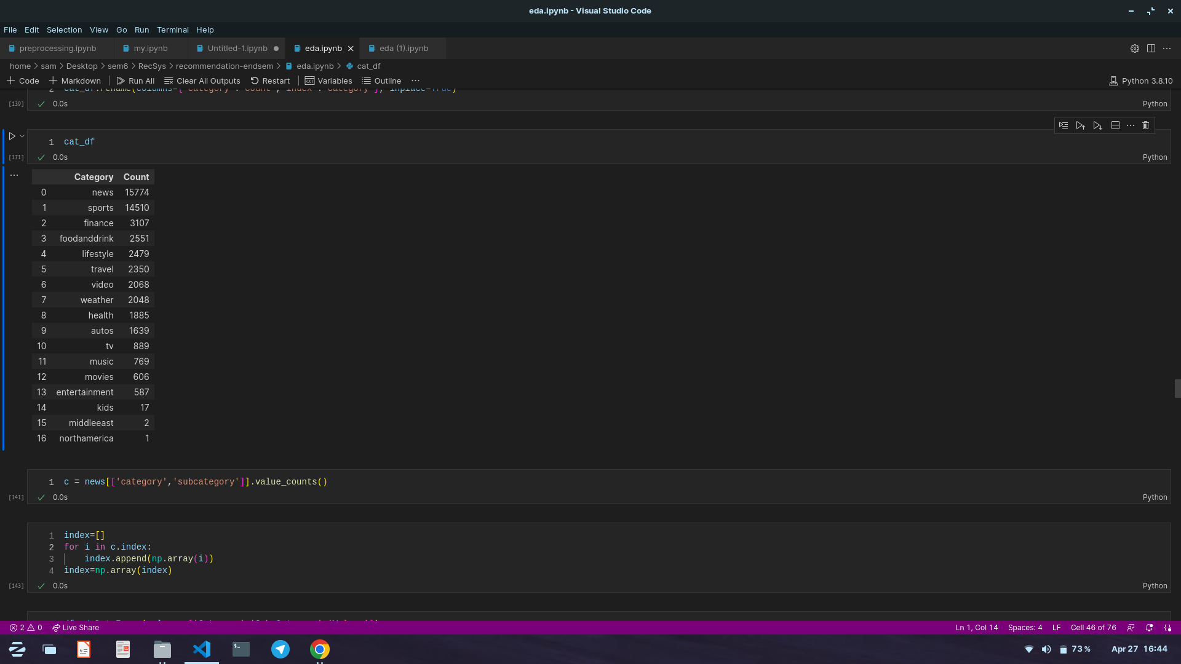
EDA

Slide 10
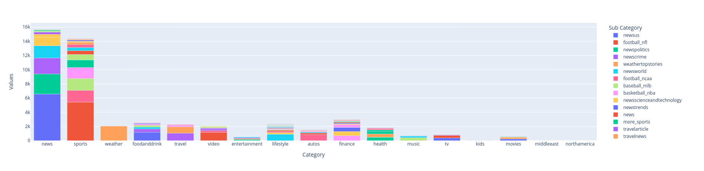
EDA

Slide 11
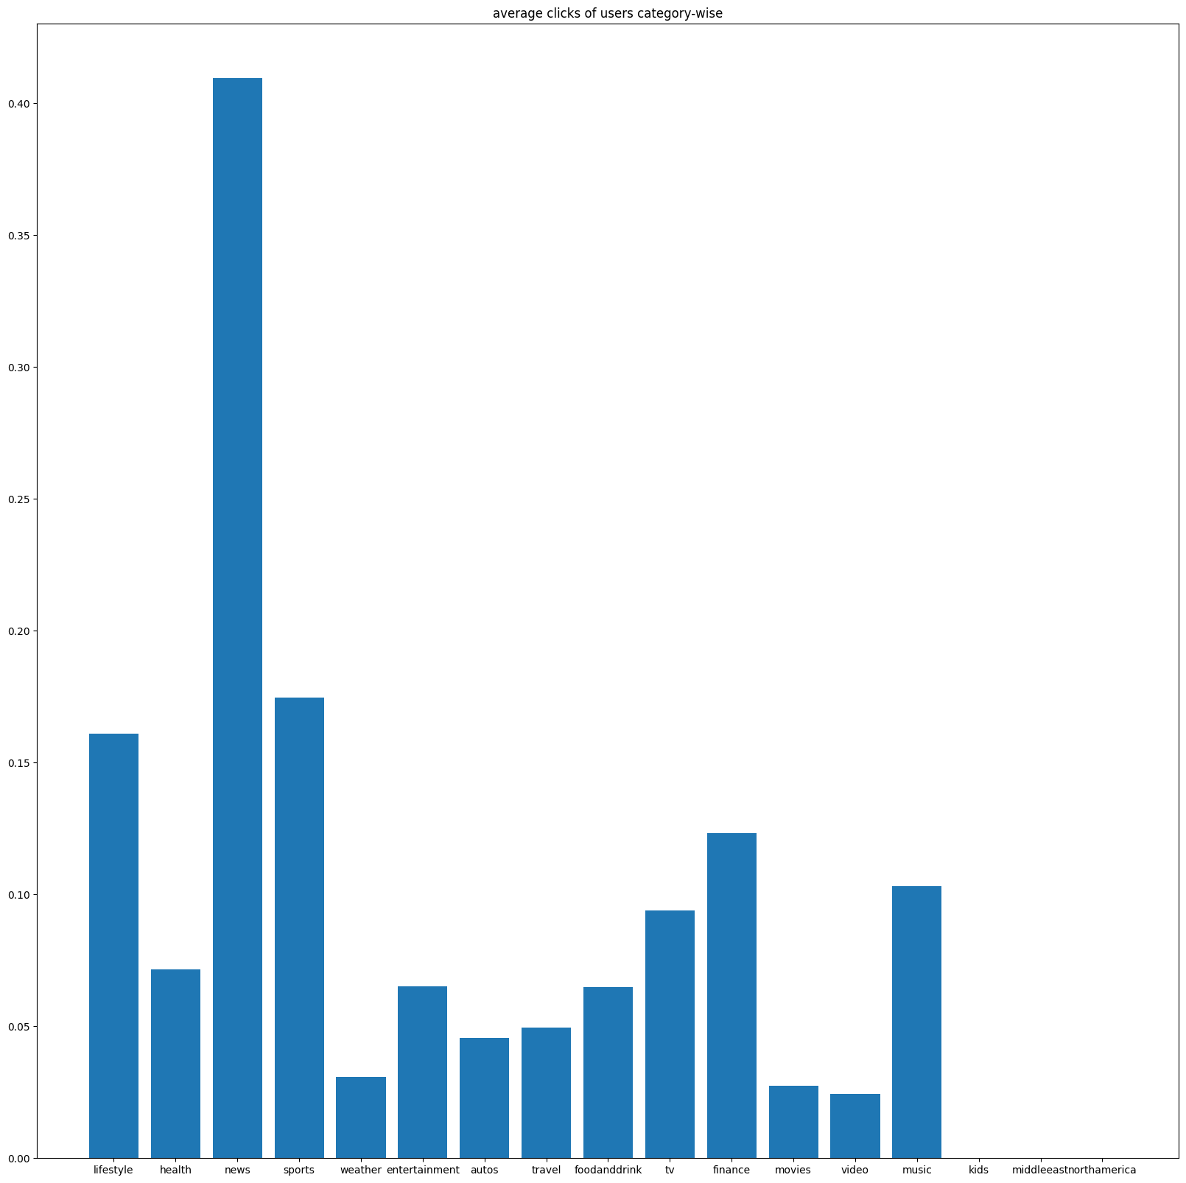
EDA
Distribution of Clicks
of users

Slide 12
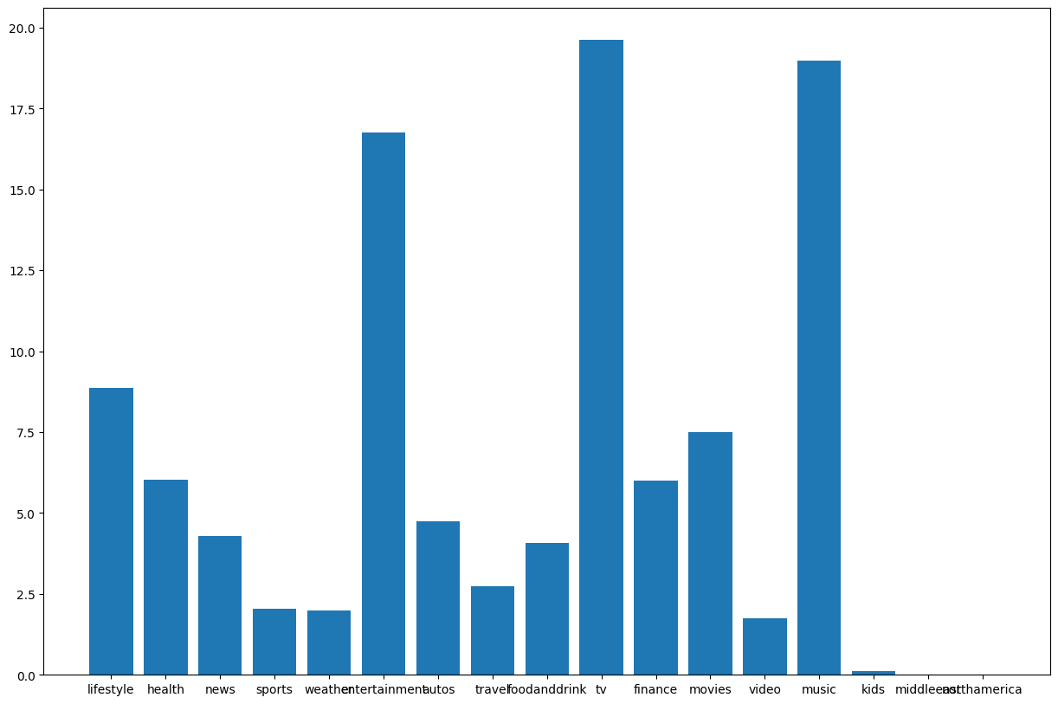
EDA
Total Clicks
No of articles

Slide 13
Pre-processing
Drop URL column - The given URL for news article is not accessible.
Replacing with empty string (" ") for NaN values.
Pre-processed the concatenated strings in the news dataset (to lower case, remove symbols, remove stop words, applied tokenization & lemmatization)
News-embeddings
User-embeddings
Creating click and non-click list for all the impressions.
Changing the data types as per the actual data type of the column.

Slide 14
News Embeddings
Used sentence transformers for embedding the news article representation.
Representation 1 - Concatenate category, subcategory, title, abstract
Representation 2 - Treat each of the above as different entity and then take the weighted average.
Representation 3 - Individually find embeddings of category, subcategory, title, abstract and then concatenate the embeddings.
Using the sentence transformer based on BERT to map sentences to a 384 dimensional vector space.

Slide 15
User Embedding
Representation - 1:
We defined the user embedding to be the mean of news article embeddings (Representation 1) in the user’s click history.
Representation 2:
‘K’ is defined as the average vectors of all the news article in the user’s click history. The weights are the values of the dot product of ‘K’ with each of the item embedding of the click history. Then we take the weighted average of these vectors with these weights for the final user embedding.
Final user representation = Σ_{j = 1}^{n} (K.v_{j}) v_{j}

Slide 16
User Embedding
Representation 3 (Attention):
In this method we construct ‘n’ new vectors V_{i}’ as below and then take the mean as the final user representation.
V_{i}’ = Σ_{j=1}^{n} (v_{i}.v_{j})v_{j}

Slide 17
User Embedding
Representation 4:
In this method we take the ‘n’ vectors V_{i} obtained in previous method, and then apply the first method for these ‘n’ vectors, to find the final user embedding.
The above mentioned methods are content based, collaborative based embeddings will be discussed later.

Slide 18
News Recommendation System
A Layman Recommendation System
K-Means Clustering
Clustering Users and News articles
Clustering Users
Clustering Articles
BPR
MAB
Trending
A different approach

Slide 19
A simple Recommendation System
Ask the user to choose some articles from randomly selected ‘25’ articles.
Method -1 : Represent this new user as the average of all these news article embeddings, now take the top 5 closest news articles to this representation and recommend them to the user.
Method -2 : For all the articles chosen by the user find the nearest articles to each of the news article and recommend to the user.
Both types of news article embeddings (category, sub-category, title, abstract as single entity and multiple entities) are used to design these 2 methods.

Slide 20
K-Means Clustering
Fixed number of clusters as 2000 for both news articles and users.
Clustering Users and News articles
After assigning the user to the cluster randomly pick 25 articles from the articles cluster which is closest to the user cluster representation.
Clustering Users
After assigning the user to the cluster randomly pick 25 articles from the articles viewed by the users in the cluster and is not seen by the user.
Clustering Articles
Assign the user to the closest Article cluster and randomly pick 25 articles from the cluster

Slide 21
Trending news articles
News article publication time assumption:
The publication time of the news article is the time of the impression it first appeared in.
Trending Article prediction is a function of the publication time and the number of clicks for the article.
Top ‘k’ articles which have the highest number of clicks in the past 2 days are considered as trending articles.

Slide 22
BPR - Bayesian Personalized Ranking
Dataset creation:
Each impression is converted into a table (liked, not liked) where each combination of (click, non-click) of this impression is placed in the table.
A user’s dataset for this model is the union of all these tables for all the user’s impressions.
Now the news article in the dataset is replaced with the Hadamard product of user embedding and the news article embedding.

Slide 23
BPR - Bayesian Personalized Ranking
Example:
1st Impression:
clicks = 1, non-clicks = 2,3
2nd Impression:
clicks = 4,5 non-clicks = 6
Liked (click) | Not liked | True/False
1 | 2 | 1
1 | 3 | 1
4 | 6 | 1
5 | 6 | 1
2 | 1 | 0
3 | 1 | 0
6 | 4 | 0
6 | 5 | 0

Slide 24
BPR - Bayesian Personalized Ranking
Prediction
Now we trained this dataset using Logistic Regression.
Suppose we have ‘k’ articles from which we need to provide the impression for the user then we need to compute k x k matrix where (i,j) cell indicates whether the user likes the news article ‘i’ compared to the news article ‘j’.
Now for each article ‘i’ maintain the vector of count of articles ‘j’ such that user likes the news article ‘i’ compared to the article ‘j’ according to the model prediction.
The articles with top ‘k’ values are the final impressions given to the user.

Slide 25
BPR - Bayesian Personalized Ranking
Prediction
 | 1 | 2 | 3 | 4
1 |  | 0 | 1 | 0
2 | 1 |  | 1 | 0
3 | 0 | 0 |  | 0
4 | 1 | 1 | 1
 | 1 | 2 | 3 | 4
count | 1 | 2 | 0 | 3

Slide 26
Learning User and Item Embeddings “collaboratively”
Consider a user with embedding u and let the embeddings that they liked and disliked be l and d respectively.
We build a model that expects the dataset containing (u, l, d) tuples.
The model “transforms” u to W_{u}u ; l and d to W_{a}l and W_{a}d, respectively.
Let the new embeddings be u’, l’ and d’.
The objective function L = Σ (<u’, l’> - <u’, d’>)
The weight matrices are learnt in such a way that L is maximized.
Some inspiration has been taken from Linear Metric Learning.
The model achieves about 66 % accuracy.
The model can easily be improved by using a neural network to learn better transformations.

Slide 27
Multi Arm Bandits - Thompson Sampling Version
This is demonstrated as a purely “Reels” version
All articles are categorised into 4 main categories. There are 4 arms and each arm represents these main categories.
Arm | Categories
Life | Lifestyle, health, weather, food and drink, travel, kids
Entertainment | Entertainment, TV, movies, sports
World | news , finance, middle-east, north america, autos
Video | video

Slide 28
Multi Arm Bandits - Thompson Sampling Version
Each arm is picked with probability p which is drawn from distribution beta(α,β).
These (α,β) are updated based on whether user liked the article or not.
Note that there are only 4 arms so that during demonstration, we can see user’s interest converge to specific category / categories quickly.

Slide 29
Future Scope
Improved user and news article embeddings.
Applying RNN to train and predict user’s preferences based on view history.
News article distribution is not uniform, so better sampling can be done.
Develop it into a web based application.
BPR set representations.
Granular user type.

Slide 30
Thank You!

